Slide 1


High Performance Cluster Computing
Architectures and Systems
Hai Jin
Internet and Cluster Computing Center

Slide 2
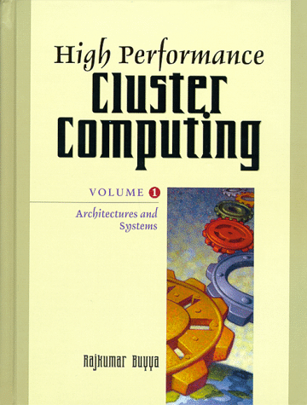
Cluster Setup and its Administration
  Introduction
  Setting up the Cluster
  Security
  System Monitoring
  System Tuning

Slide 3
Introduction (1)
Affordable and reasonably efficient clusters seem to flourish everywhere
  High speed networks and processors start becoming commodity H/W
  More traditional clustered systems are steadily getting somewhat cheaper
  Cluster system is no longer too specific, too restricted access system
New possibilities for researchers and new questions for system administrators

Slide 4
Introduction (2)
Beowulf project is the most significant event in the cluster computing
  Cheap network, cheap node, Linux
Cluster system
  Not just a pile of PC’s or workstation
    Getting some useful work done can be quite a slow and tedious task
  A group of RS/6000 is not an SP2
  Several UltraSPARCs also can’t make an AP-3000

Slide 5
Introduction (3)
There is a lot to do before a pile of PCs become a single, workable system
Managing a cluster
  Facing requirement completely different from more conventional systems
  A lot of hard work and custom solutions

Slide 6
Setting up the Cluster
Setup of Beowulf-class clusters
Before design the interconnection network or the computing nodes, we must define “The cluster purpose” with as much detail as possible

Slide 7
Starting from Scratch (1)
Interconnection Network
  Network technology
    Fast Ethernet, Myrinet, SCI, ATM
  Network topology
    Fast Ethernet (hub, switch)
      Some algorithms show very little performance degradation when changing from full port switching to segment switching, and cheap
    Direct point-to-point connection with crossed cabling
      Hypercube
        16 or 32 nodes because of the number of interfaces in each node, the complexity of cabling and the routing (software side)
    Dynamic routing protocol
      More traffic and complexity
  OS support for bonding several physical interfaces into a single virtual one for higher throughput

Slide 8
Starting from Scratch (2)
Front-end Setup
  NFS
    Most cluster have one or several NFS server node
    NFS is not scalable or fast, but it works; user will want an easy way for their non I/O-intensive jobs to work on the whole cluster with the same name space
  Front-end
    Some distinguished node where human users log-in from the rest of the network
    Where they submit jobs to the rest of cluster

Slide 9
Starting from Scratch (3)
Advantage of using Front-end
  Users log in, compile and debugging, and submit jobs
  Keep the environment as similar to the node as possible
  Advanced IP routing capabilities: security improvements, load-balancing
  Provide ways to improve security, but makes administration much easier: single system
  Management: install/remove S/W, logs for problem, start/shutdown
  Global operations: running the same command, distributing commands on all or selected nodes

Slide 10
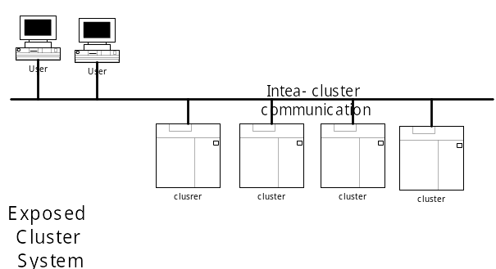
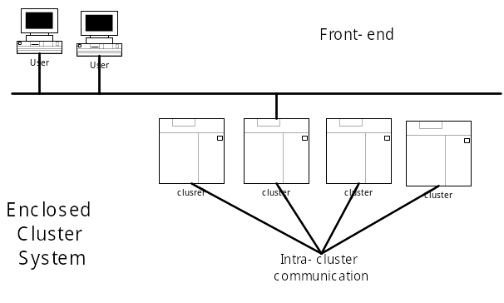
Two Cluster Configuration Systems

Slide 11
Starting from Scratch (4)
Node Setup
  How to install all of the nodes at a time?
    Network boot and automated remote installation
    Provided that all of nodes will have same configuration, the fastest way is usually to install a single node and then make clone
  How can one have access to the console of all nodes?
    Keyboard/monitor selector: not a real solution, and does not scale even for a middle size cluster
    Software console

Slide 12
Directory Services inside the Cluster
A cluster is supposed to keep a consistent image across all its nodes, such as same S/W, same configuration
Need a single unified way to distribute the same configuration across the cluster

Slide 13
NIS vs. NIS+
NIS
  Sun Microsystems’ client-server protocol for distributing system configuration data such as user and host names between computers on a network
  Keeping a common user database
  Has no way of dynamically updating network routing information or any configuration changes to user-defined applications
NIS+
  Substantial improvement over NIS, is not so widely available, is a mess to administer, and still leaves much to be desired

Slide 14
LDAP vs. User Authentication
LDAP
  LDAP was defined by the IETF in order to encourage adoption of X.500 directories
  Directory Access Protocol (DAP) was seen as too complex for simple internet clients to use
  LDAP defines a relatively simple protocol for updating and searching directories running over TCP/IP
User authentication
  Foolproof solution of copying the password file to each node
  As for other configuration tables, there are different solutions

Slide 15
DCE Integration
Provides a highly scalable directory service, security service, a distributed file system, clock synchronization, threads, RPC
  Open standard but not available certain platforms
  Some of its services have already been surpassed by further developments
DCE threads are based on early POSIX draft and there have been significant changes since then
DCE servers tend to be rather expensive and complex
DCE RPC has some important advantages over the Sun ONC RPC
DFS is more secure and easier to replicate and cache effectively than NFS
  Can be more useful large campus-wide network
  Support replicated servers for read-only data

Slide 16
Global Clock Synchronization
Serialization needs global time
  failing to do so tend to produce subtle and difficult to track errors
In order to implement a global time service
  DCE DTS (Distributed Time Service): better than NTP
  NTP (Network Time Protocol)
    Widely employed on thousands of hosts across the Internet and provides support for a variety of time resource
    Needs for a strict UTC synchronization
  Time servers
  GPS

Slide 17
Heterogeneous Clusters
Reasons for heterogeneous clusters
  Exploiting higher floating point performance of certain architectures and the low cost of other system, or for research purposes
  NOWs. Making use of idle hardware
Heterogeneous means automation administration work will become more complex
  File system layouts converging but still far from coherent
  Software packaging different
  POSIX attempting standardization has little success
  Administration command are also different
Solution
  Develop a per-architecture and per-OS set of wrappers with common external view
Endian difference, world length difference

Slide 18
Some Experiences with PoPC Clusters
Borg: a 24 Linux node Cluster at LFCIA laboratory
  AMD K6 processor, 2 Fast Ethernet
  Front-end is dual PII with an additional network interface, act as a gateway to external workstations.
  Front-end monitoring the nodes with mon
  24 Port 3Com SuperStack II 3300: managed by serial console, telnet, HTML client & RMON
  Switches - suitable point for monitoring, most of the management is done by the switch itself
While simple and not expensive, this solution is giving good manageability, keeping the response time low and providing more than enough information when need

Slide 19
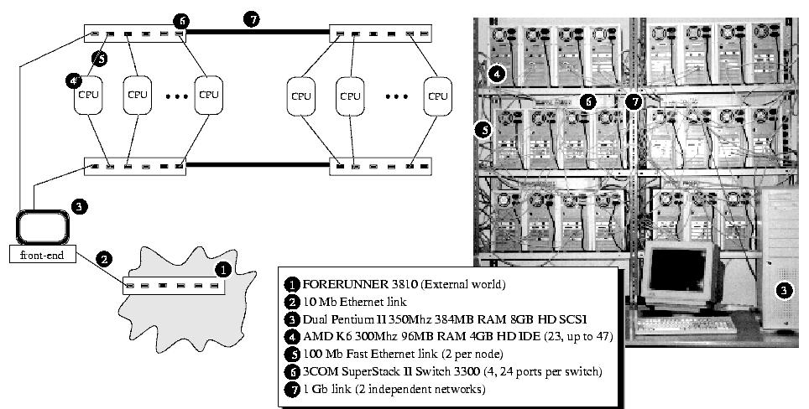
borg, the Linux Cluster at LFCIA

Slide 20
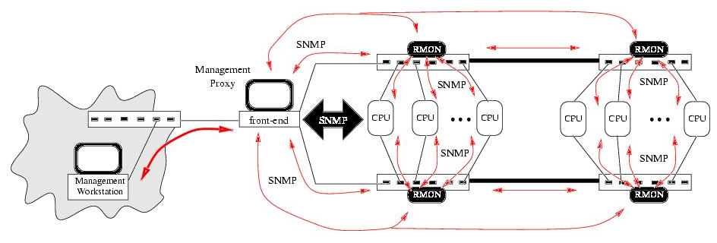
Monitoring the borg

Slide 21
Security Policies
End users have to play an active role in keeping a secure environment
  The real need for security
  The reasons behind the security measure taken
  The way to use them properly
Tradeoff between usability and security

Slide 22
Finding the Weakest Point in NOWs and COWs
Isolating services from each other is almost impossible
While we all realize how potentially dangerous some services are, it is sometimes difficult to track how these are related with other seemingly innocent ones
Allowing rsh access from the outside is bad
Single intrusion implies a security compromises for all of them
A service is not safe unless all of the services it depends on are at least equally safe

Slide 23
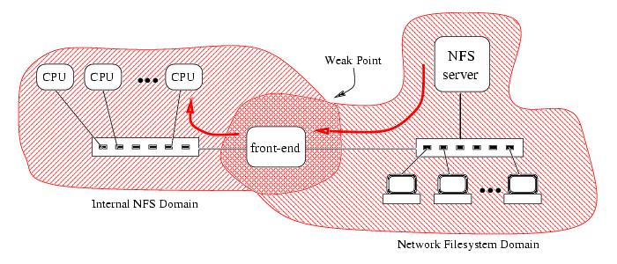
Weak Point due to the Intersection of Services

Slide 24
A Little Help from a Front-end
Human factor: destroying consistency
Information leaks: TCP/IP
Clusters are often used from external workstations in other networks
  Justify a front-end from a security viewpoint in most cases - serve as a simple firewall

Slide 25
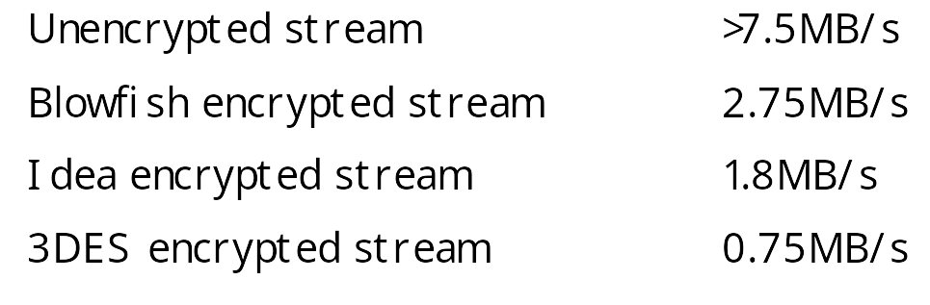
Security versus Performance Tradeoffs
Most security measures have no impact on performance and proper planning can avoid that impact
Tradeoffs
  More usability versus more security
  Better performance versus more security
The case with strong ciphers

Slide 26
Clusters of Clusters
Building clusters of clusters is common practice for large-scale testing. But special care must be taken on the security implications when this is done
Building secure tunnels between the clusters, usually from front-end to front-end
Unsafe network, high security requirements - a dedicated tunnel front-end or keeping the usual front-end free for just the tunneling
Nearby clusters in the same backbone - letting the switches do the work
VLAN: using trusted backbone switch

Slide 27
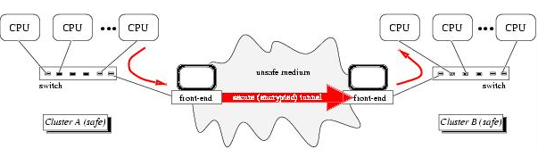
Intercluster Communication using a Secure Tunnel

Slide 28
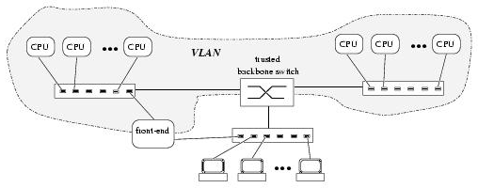
VLAN using a
Trusted Backbone Switch

Slide 29
System Monitoring
It is vital to stay informed of any incidents that may cause unplanned downtime or intermittent problems
Some problems that are trivially found in single system may be hidden for long time they are detected

Slide 30
Unsuitability of General Purpose Monitoring Tools
Main purpose - network monitoring, not the case with cluster
This obviously is not the case with clusters. The network is just a system component, even if a critical one, but the sole subject of monitoring in itself
In most cluster setups it is possible to install custom agents in the nodes
  track usage, load, and network traffic, tune OS, find I/O bottleneck, foresees possible problem, or balance future system purchase

Slide 31
Subjects of Monitoring (1)
Physical Environment
  Candidates for monitoring subject
    Temperature, humidity, supply voltage
    The functional status of moving parts (fans)
  Keep some environmental variables stable within reasonable value greatly help keeping the MTBF high

Slide 32
Subjects of Monitoring (2)
Logical Services
  Logical services is aimed at finding current problems when they are already impacting the system
  A low delay until the problem is detected and isolated must be a priority
  Find error or misconfiguration
  Logical services range
    Low level like raw network access and running processor
    High level like RPC and NFS services running, correct routing
  All monitoring tools provide some way of defining customized scripts for testing individual services
    Connecting to the telnet port of a server and receiving the “login” prompt is not enough to ensure that users can log in; bad NFS mounts could cause their login scripts to sleep forever

Slide 33
Subjects of Monitoring (3)
Performance Meters
  Performance meters tend to be completely application specific
    Code profiling => side effect time and cache
    Spy node => for network load-balancing
  Special care must be taken when tracing events that spawn several nodes
    It is very difficult to guarantee a good enough cluster wide synchronization

Slide 34
Self Diagnosis and
Automatic Corrective Procedures
Taking corrective measures
Making the system take these decisions itself
Taking automatic preventive measures
Most actions end up being “page the administrator”
In order to take reasonable decisions, the system should know what sets of symptoms lead to suspect of what failures, and appropriate corrective procedures to take
For any nontrivial service the graph of dependencies will be quite complex, and this kind of reasoning almost asks for an export system
Any monitor performing automatic corrections should be at least based on rule-based system and not rely on direct alert-action relations

Slide 35
System Tuning
Developing Custom Models for Bottleneck Detection
  No tuning can be done without define goals
  Tuning a system can be seen as minimizing a cost function
    Higher throughput for job may not be help increases network
  No performance gain comes for free, and often means tradeoff
    Performance, safety, generality, interoperability

Slide 36
Focusing on Throughput or Focusing on Latency
Most UNIX systems tuned for high throughput
  Adequate for general timesharing system
Cluster are frequently used as a large single user system, the main bottleneck is latency
Network latency tends to be especially critical for most applications but H/W dependent
  Lightweight protocol do help somewhat, but with the current highly optimized IP stacks there is no longer a huge difference in most H/W
Each node can be consider as just component of the whole cluster, and its tuning aimed at global performance

Slide 37
I/O Implications
I/O subsystems as used in conventional servers are not always a good choice for cluster nodes
Commodity off-the-shelf IDE disk drives are cheaper and faster and even have the advantage of a lower latency than most higher-end SCSI subsystems
  While they obviously don’t behave as well under high load, it is not always a problem, and the money saved may mean more additional nodes
As there is usually a common shared space from a server, a robust, faster and probably more expensive disk subsystem will be better suited there for the large number of concurrent accesses
The difference between raw disk and filesystem throughput becomes more evident as systems are scaled up
  Software RAID: distributing data across node
  Raw disk and file system throughput becomes more evident as systems are scaled up

Slide 38
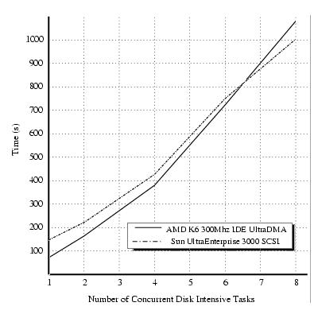
Behavior of Two Systems in a Disk Intensive Setting

Slide 39
Caching Strategies
There is only one important difference between conventional multiprocessors and clusters
  Availability of shared memory
The only factor that cannot be hidden is the completely different memory hierarchy
Usual data caching strategies may often have to be inverted
  Local disk is just a slower, persistent device for large term storage
  Faster rates can be obtained from concurrent access to other nodes
    Wasting other nodes resources
    Saturated cluster with overloaded nodes may perform worse
Getting a data block from the network can provide both lower latency and higher throughput than from the local disk

Slide 40
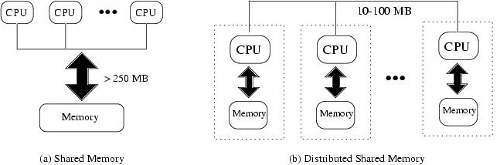
Shared versus Distributed Memory

Slide 41
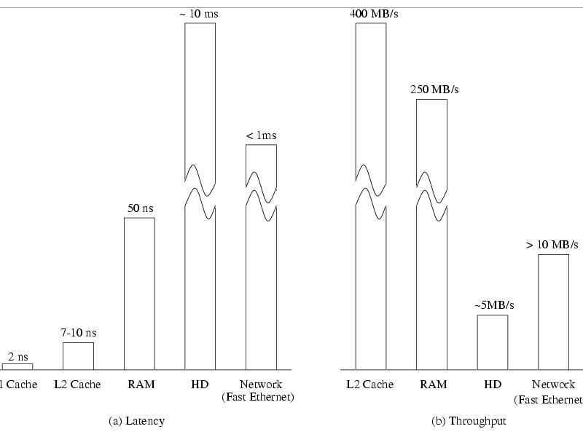
Typical Latency and
Throughput for a Memory Hierarchy

Slide 42
Fine-tuning the OS
Getting big improvements just by tuning the system is unrealistic most time
Virtual memory subsystem tuning
  Optimizations depend on the application, but large jobs often benefit from some VM tuning
  Highly tuned code will fit the available memory, keep the system from paging until a very high watermark has been reached
  Tuning the VM subsystem has been traditional for large system as traditional Fortran code uses to overcommit memory in a huge way
Networking
  When the application is communication-limited
  For bulk data transfers, increasing the TCP and UDP receive buffers, large windows and windows scaling
  Inside clusters, limiting the retransmission timeouts; switches tend to have large buffers and can generate important delays under heavy congestion
  Direct user-level protocols

